Slide 1
DBMS
CSE-307

Slide 2
Keys
Super key
Candidate Key
Primary Key
Foreign Key
Composite Key

Slide 3
Keys(cont.)
Super Key:
Defined by two ways: By single column Or By set of columns
When the data is uniquely identified by single column, called Super key. Example: {Reg_no},{Customer_id} etc.
When the data is not identified by single column, then two/three/four columns collectively identified the data; These two/three/four columns set is called Super key.
Example: {Name} is not a Super Key, {cgpa} is not a Super key, {District} is not Super Key.

Slide 4
Keys(cont.)
Super Key:
{Name, Batch, District, Father_name} is a Super Key
{customer-name, customer-id}, {all attribute} Super key

Slide 5
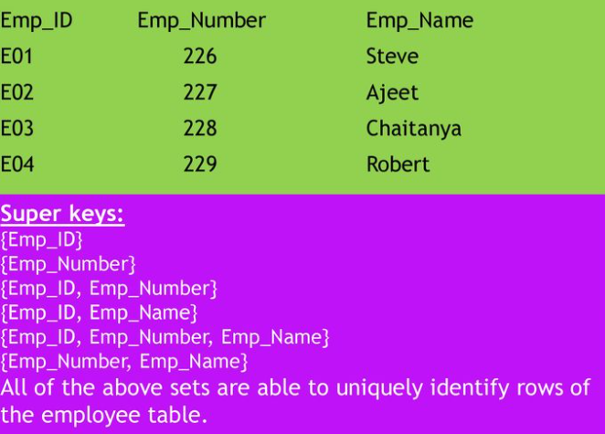
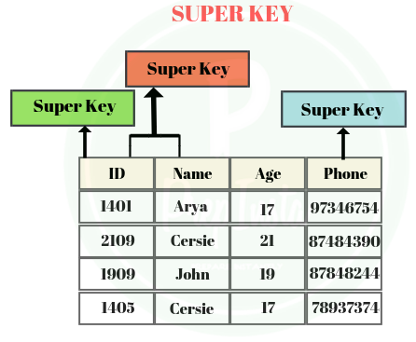
Keys(cont.)
Super Key:

Slide 6
Keys(cont.)
Candidate Key:
To be Candidate key, should be Super key. (Without DIU student, its not possible to be CSE, DIU student)
As like Super Key, Candidate key may defined by two ways: Single or Multiple columns
Single Column's all Super key’s are Candidate Key. That means- {Customer_id}, {Reg_no} are Candidate key.
When multiple columns set makes Super Key, at that time, if any of that set is individually Super Key, then that Super key’s set is not Candidate Key.

Slide 7

Keys(cont.)
Super Key & Candidate Key:

Slide 8
Keys(cont.)
Attributes | Super Key? | Candidate Key? | Comments
{ Customer_id} | YES | YES | Cause, it’s a single column Super Key
{Name} | NO | NO | Cause, its not a Super key; so impossible to candidate key.
{Reg_no, Name, District} | YES | NO | Reg_no is individually Super Key
{ Name, Batch, Father_Name, District} | YES | YES | No individual super key

Slide 9

keys
Primary Key:
Single column’s all Super/Candidate Key’s are Primary Key.
When the data is identified by single column, called Primary key. Example: {Reg_no}, {Customer_id} etc.

Slide 10
Relation between keys
Primary Key (subset of) candidate Key (subset of) Super Key
CSE_Eve-72(subset of) CSE (subset of) DIU

Slide 11
More keys
Foreign Key:
When any Table/Relations primary key is used in another Table/Relation, then according to the second Table, this column is called Foreign key.
Example: Table-A(Reg_no, Name, cgpa, District)
Table-B(Reg_no, Birth_date, Phon_no)
Here B.Reg_no is a Foreign Key.

Slide 12
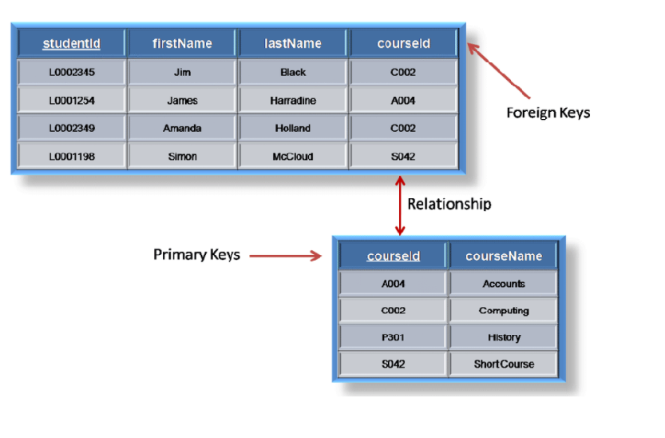
Relation between primary & foreign key

Slide 13
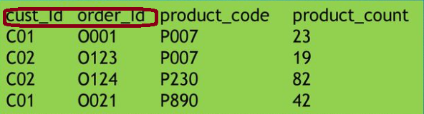
More Keys
Composite Key:
One kinds of Candidate key
Consists of more than one column to idendify the data

